Slide 1

Program Orientation + Mentoring 101 Training
Developed By MENTOR Maryland|DC

Slide 2
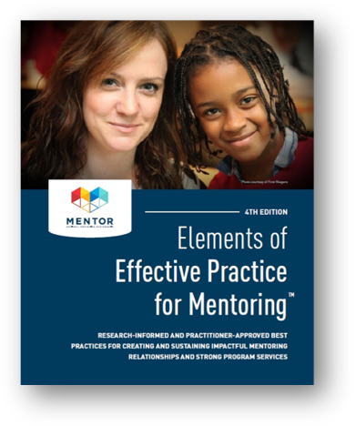
MENTOR MD|DC Resources
Elements of Effective Practice for Mentoring
Upcoming and Ongoing Trainings for Mentoring Programs
Past Trainings and Webinars
National Mentoring Resource Center
MENTOR National Resource Library

Slide 3
Instructional Slide
*remove before presenting*
This template deck is a two-part training that includes your programs orientation and pre-training for new mentors
  Program orientation is approx. 60 minutes
  Pre-training is approx. 90-120 minutes
  Can be done at once or in two separate sessions, in person or virtually
The deck is meant to be a skeletal version and you are free to customize, add, and remove at your will
All highlighted items are meant for info that is unique to your program

Slide 4
[Program Name] Orientation
Welcome New Mentors!

Slide 5

Introductions
Please share with us…
Name
Pronouns
Number of years of experience being a mentor

Slide 6
About MENTOR MD|DC
Since Maryland’s affiliate of MENTOR: The National Mentoring Partnership launched in 2018, Maryland MENTOR has sought to uplift the urgency of a march toward quality mentoring. With the mission and vision to increase the quality and quantity of mentoring relationships across the country and to close the mentoring gap, we know programs can only do this when they feel supported, empowered and have the tools and resources to sufficiently carry out safe and effective mentoring relationships.
Maryland MENTOR is a non-partisan organization that galvanizes the Maryland mentoring movement. We serve as community-based experts and create statewide infrastructure to expand quality relationships for young people. We fulfill this role through our unique role as a unified clearinghouse for training, research, public awareness, mentor recruitment, and advocacy. Maryland MENTOR provides the critical link between MENTOR’s national efforts and local organizations and programs that foster and support quality mentoring relationships across the state.

Slide 7
[Program Name] Team
Insert picture here
Insert picture here
Insert picture here
Insert picture here
Name
Role
Name
Role
Name
Role
Name
Role

Slide 8
Agenda
Welcome
Introductions/ webinar logistics/ learning objectives
Origins of program
Mission, vision, & goals
Policies & procedures
Program design
Our youth and how you will be working with them
Monitoring process
Key contacts
Questions
Wrap Up

Slide 9

Webinar Logistics
Please remain muted unless called upon by speaker.
Use the chat-box for comments, questions, ‘aha’ moments, additional resources, and responding to requests from the speaker; make sure to type to all “panelist and attendees”.
You may also raise your hand for when the speaker asks/calls on volunteers.
Towards the end of the presentation, we ask that you please complete our session evaluation.
Additional questions that you may have are to be held until after the evaluation process is complete!
Remember, things happen. So, please give us and each other “s p a c e” and grace !
Have fun & learn!

Slide 10
Mentors will…
Understand our history, mission, and goals
01
Learn about the youth we serve and what supports they need
02
Learn how you will be working with our youth
03
Understand how the program is designed
04
Understand the importance of monitoring and check ins
05

Slide 11

Ice Breaker
Share with us 3 people you would have join you at dinner. You can choose anyone you desire, family, friends, mentors, role models, idols, those who have passed and tell us why.

Slide 12
[Program Name] Origins
*Insert program history*

Slide 13
Program Design
*insert description here*

Slide 14



Mission: *insert text*
Vision: *insert text*
Goals: *insert text*

Slide 15
Our Youth
*Insert mentee description*
*include pictures*
*Or consider having a mentee or mentees present to present during this section

Slide 16
What are we asking of you?
*Insert screening procedures*
Attend program orientation and mentor pre-training
Complete requested forms and evaluations
Time Commitment
  *insert frequency of meetings here*
  *insert length of commitment* (best practice is at least 6 months)
*insert responsibilities*

Slide 17
Mentor Responsibilities
*Insert mentor position description*
*Insert program boundaries (standards of safety)*

Slide 18
Policies & Procedures
Insert the following:
  Explain your org's mandated reporting policy
  Social Media policy
  Reporting absences
  Parent/family communication
  Outside of program communication
  Supervision (number of adults/children in a space, being observable)

Slide 19

Key Contacts
*insert contact name, role, email, phone number*
Who to contact for what?

Slide 20

Mentoring FAQs
What if my mentee asks me for money?
What if my mentee's family doesn't like me?
What if my mentee doesn’t talk to me?

Slide 21
Questions

Slide 22
Mentoring 101:
How to Be an Effective Mentor
[Program Name]

Slide 23
Agenda
Welcome
Introductions/ Webinar Logistics/ Learning Objectives
Expectations of the Mentoring Relationship
Role of a Mentor, Mentor Tasks & Approaches
Communication (Reflective Listening, Open vs Closed Responses)
How to Set Healthy Boundaries (types, language, challenges)
How Mentoring Combats Trauma & Violence
Roadblocks to Cultivating A Supportive Relationship
How to Have Conversations about Race
Questions
Wrap Up

Slide 24
In this training you will learn…
The scope and limits of your role as a mentor
Approaches to mentoring/mentor tasks
How to set boundaries
Effective communication
How to support young people in the wake of violence and trauma

Slide 25
Ice Breaker
Tell us a song, movie, or book that describes your mentoring style...

Slide 26
Expectations in Mentoring
Ask Yourself…
What do you expect to gain from this relationship?
What expectations do you have for your mentee going into this relationship?
Are your expectations realistic? Could they impede on your mentee’s wellbeing?
Notes:
Ask for volunteers to share.
The main reason why Relationship (any relationship) fails is because of: Lack of Communication & Unmet Expectations

Slide 27
“The delicate balance of mentoring someone is not creating them in your own image, but giving them the opportunity to create themselves.” – Steven Spielberg
Notes:
Is someone willing to read this?

Slide 28
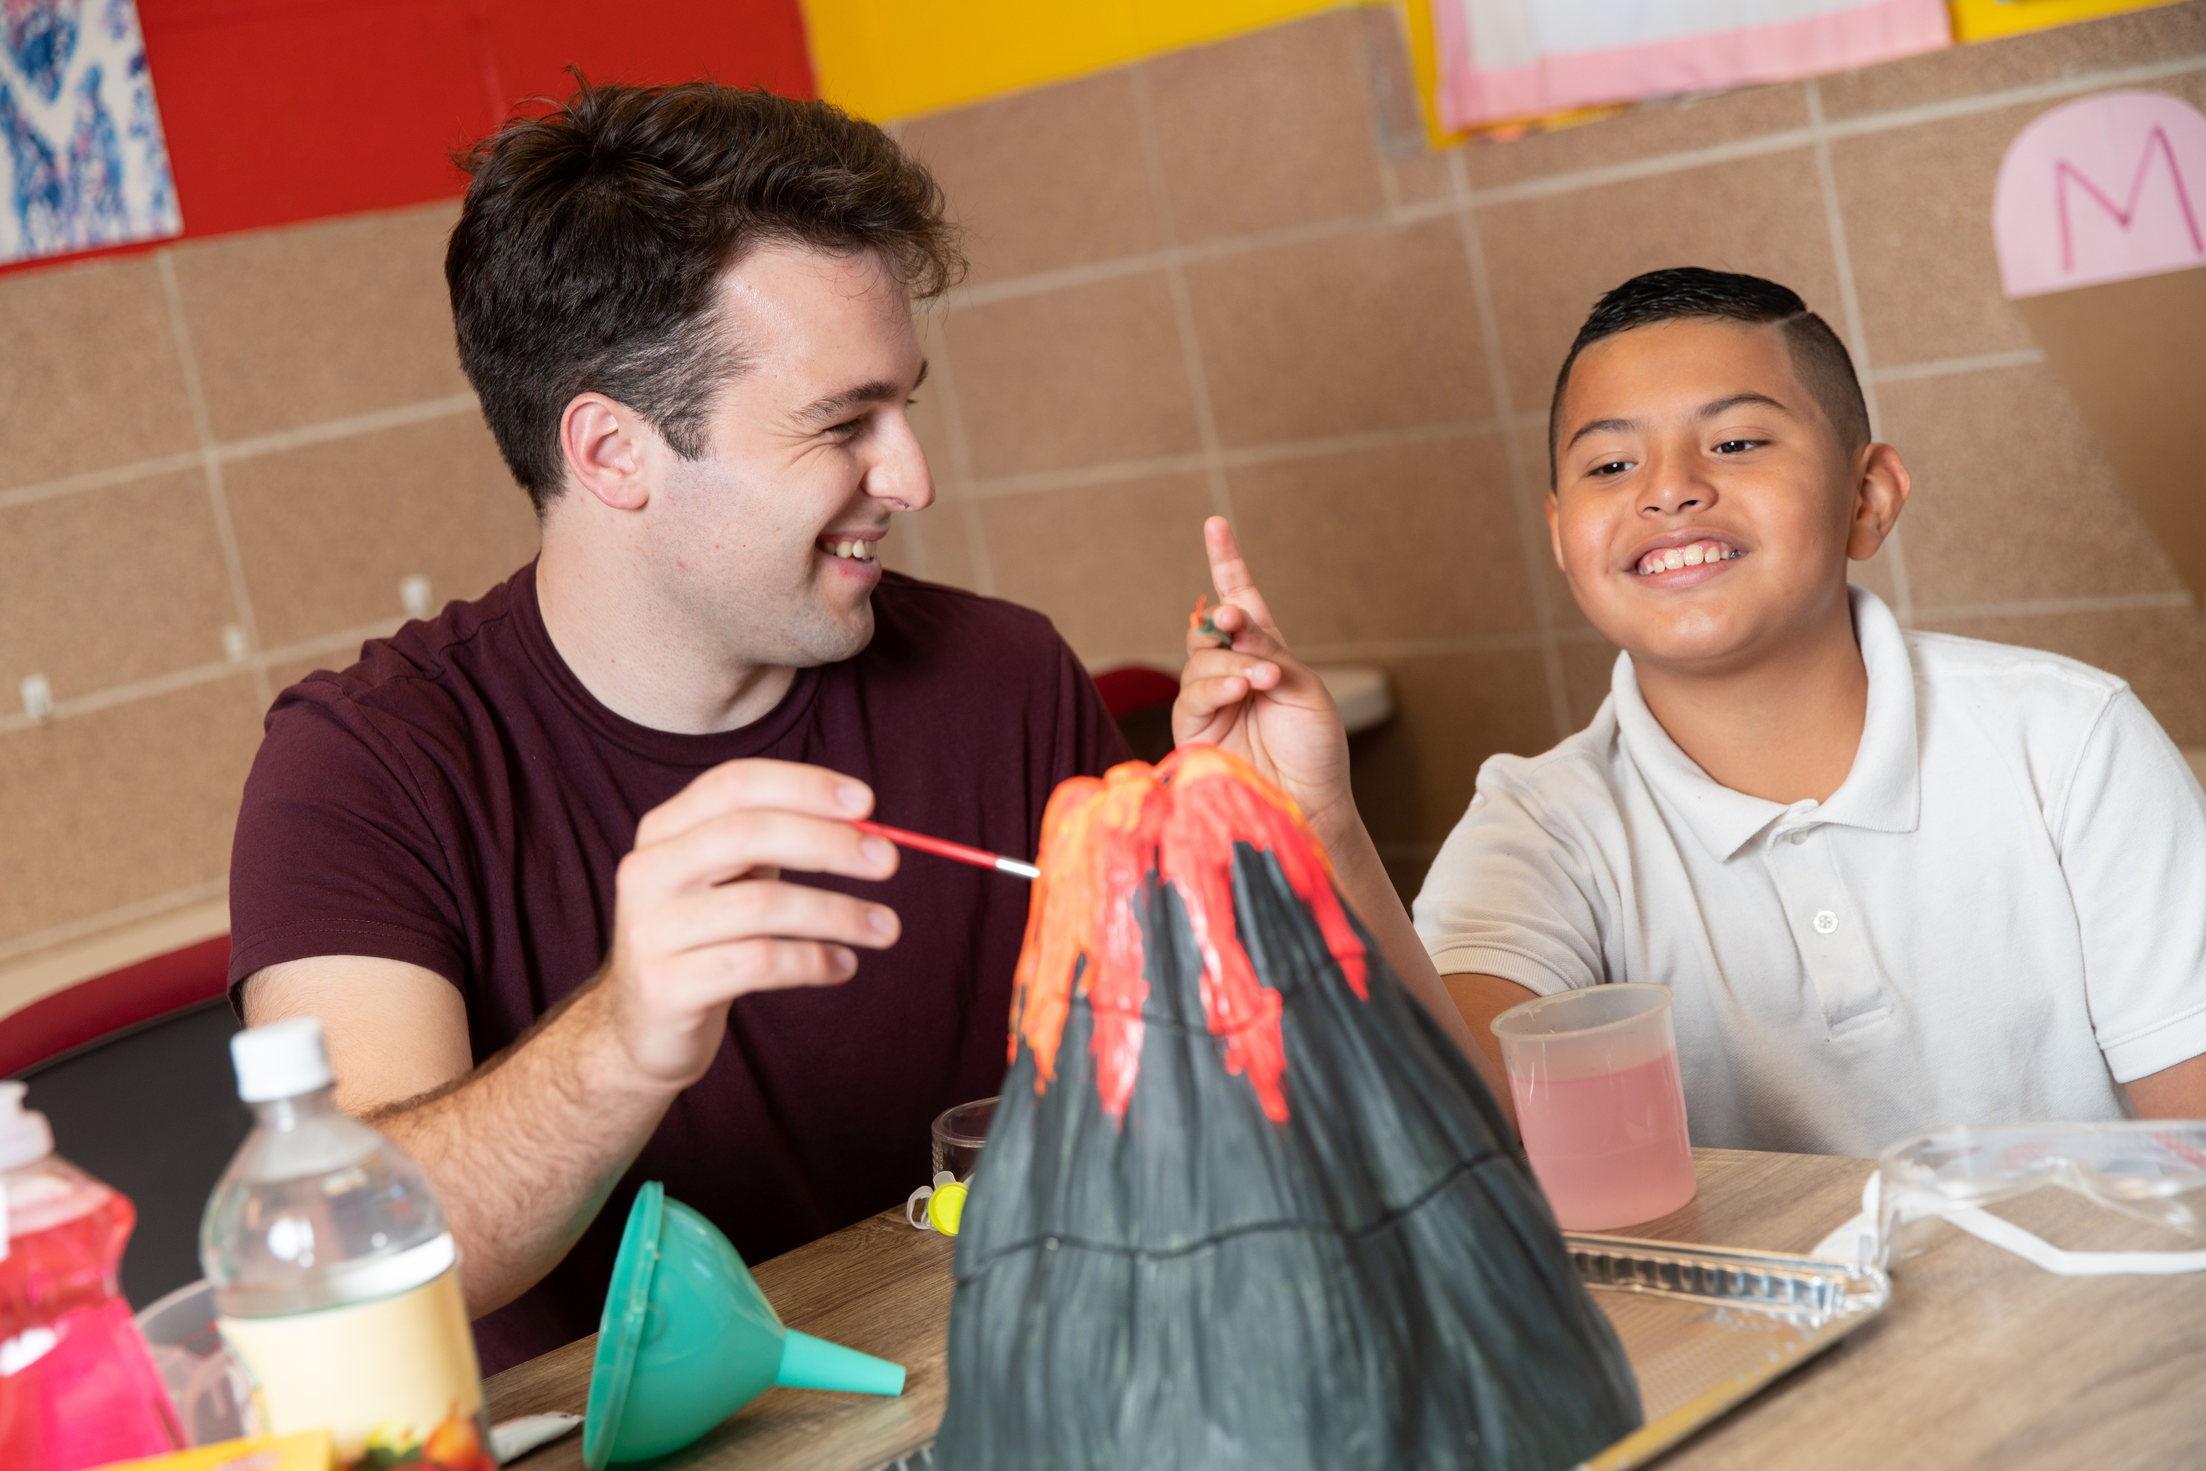
What is a Mentor?
Notes:
ASK: By a show of hands (via webcam or raise hand tool), how many of you have had a mentor?
SAY: I’d like to invite each of you to think about the quality your mentor had or has that helped them form a trusting relationship with you.
ASK: What did they do that let you know you could trust them? (unmute or put in chat)
Optional: Use polleverywhere.com to create a word cloud. Poll everywhere should be set up ahead of time.

Slide 29
A Mentor is…
“… a caring guide, a wise advisor, a partner on a journey, a trusted
friend. A mentor can serve as a mirror for the youth. They can show
youth who they are and all they can become...what makes a mentor
‘a Mentor’ is not that they are perfect or always know exactly what to
say, but rather that they are able to form a strong connection with
their mentee. This connection can serve as a catalyst for positive change and growth.”
Source: Arevalo, Elsy, Boggan, DeVone, & West, Lynne. (2004). Designing and Customizing Mentor Training. Center for Applied Research Solutions, Inc. California Department of Alcohol and Drug Programs.

Slide 30
Mentor Roles
A mentor is… | A mentor is not…
Friend | Surrogate parent
Coach | School Teacher
A nurturer of possibilities | Disciplinarian
Motivator | Psychologist
Advisor | ATM Machine
Listener | Therapist
Advocate | Savior
Notes:
Pick a few to Highlight that relate to your program specifically.
Then Top 2 things ALL Mentees say they want in a mentor is
Non-Judgmental
Good Listener
Mentoring is ALL about relationships
Building a relationship takes time
Are you in a position to truly give your time?
If you aren’t able to see your mentee due to a conflict, take time to write a note – has a lasting impact
Go through each concept listed below
How many of you did everything your parents asked you to do? No one wants advise
Check yourself if you are doing the savior complex
We are here to advocate and listen to our mentees
The most important thing is for you to be YOU which nurtures responsibility
Validate emotions
Have teachable moments
Let’s both take 10 minutes to use our phones and then we will put them away
Set boundaries

Slide 31
Mentor Tasks
Establish a positive, personal relationship with mentee
Help mentee to develop or begin to develop life skills
Assist mentee in identifying additional resources
Increase mentee’s ability to interact with people/groups/things from various backgrounds

Slide 32
Trauma in Young People
More than two thirds of children reported at least 1 traumatic event by age 16
The national average of child abuse and neglect victim in 2015 was 9.2 victims per 1,000 children
Estimated rates of witnessing community violence range from 39%-85%

Slide 33

Trauma
The personal experience of interpersonal violence including sexual abuse, physical abuse. Severe neglect, loss, and/or the witnessing of violence, terrorism, urban violence, war/combat, motor vehicle accidents and disasters
Events that are shocking terrifying and/or overwhelming to the individual
Results in feelings of horror, fear, helplessness
Trauma occurs when an external threat overwhelms a person’s internal and external positive coping resources
SAMHSA's concept of trauma and guidance for a Trauma ... (2014, July). Retrieved April 26, 2021, from https://ncsacw.samhsa.gov/userfiles/files/SAMHSA_Trauma.pdf

Slide 34
The Three E’s in Trauma
Events
Events/circumstances cause trauma
Experience
An individuals experience of the event determines whether it is traumatic
Effects
Effects of trauma include adverse, physical, social, emotional, or spiritual consequences

Slide 35
Traumatic Events May Affect a Childs…
Brain Development
Sense of Personal Safety
Ability to Trust Others
Sense of the Future
Behavior and Social Relationships
Effectiveness in Navigating Life Changes
Educational Performance: Capacity to Learn
Region 3 Behavioral Health Services. (2016, June 22). Retrieved April 26, 2021, from https://region3.net/Portals/0/Annual%20Reports/Region%203_AR2016_WEB.pdf

Slide 36

Trauma is often overlooked because…
Behavioral responses resemble common delinquent behaviors and are under-identified as trauma symptoms
Stress manifestation is different by ages and stages
Many just don’t connect the symptoms or behaviors displayed to trauma… thus leading to punishment rather than help
Region 3 Behavioral Health Services. (2016, June 22). Retrieved April 26, 2021, from https://region3.net/Portals/0/Annual%20Reports/Region%203_AR2016_WEB.pdf

Slide 37
Things To Remember
Underlying Question =
“What happened to you?”
Symptoms =
Adaptions to traumatic events
Healing Happens
In relationships

Slide 38
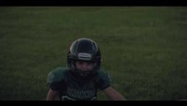

Slide 39
The Power of a Caring, Consistent Adult
Supportive Adults Can…
Help protect and buffer children from toxic stress.
Help children heal and build resiliency.
Reduce levels of hormones present in children and as a result, reduce the impact of trauma.
Supportive adults should celebrate, comfort, listen to, collaborate with, and inspire young people in order to build strong relationships.
Science. (2019, November 20). Retrieved April 26, 2021, from https://changingmindsnow.org/science/

Slide 40
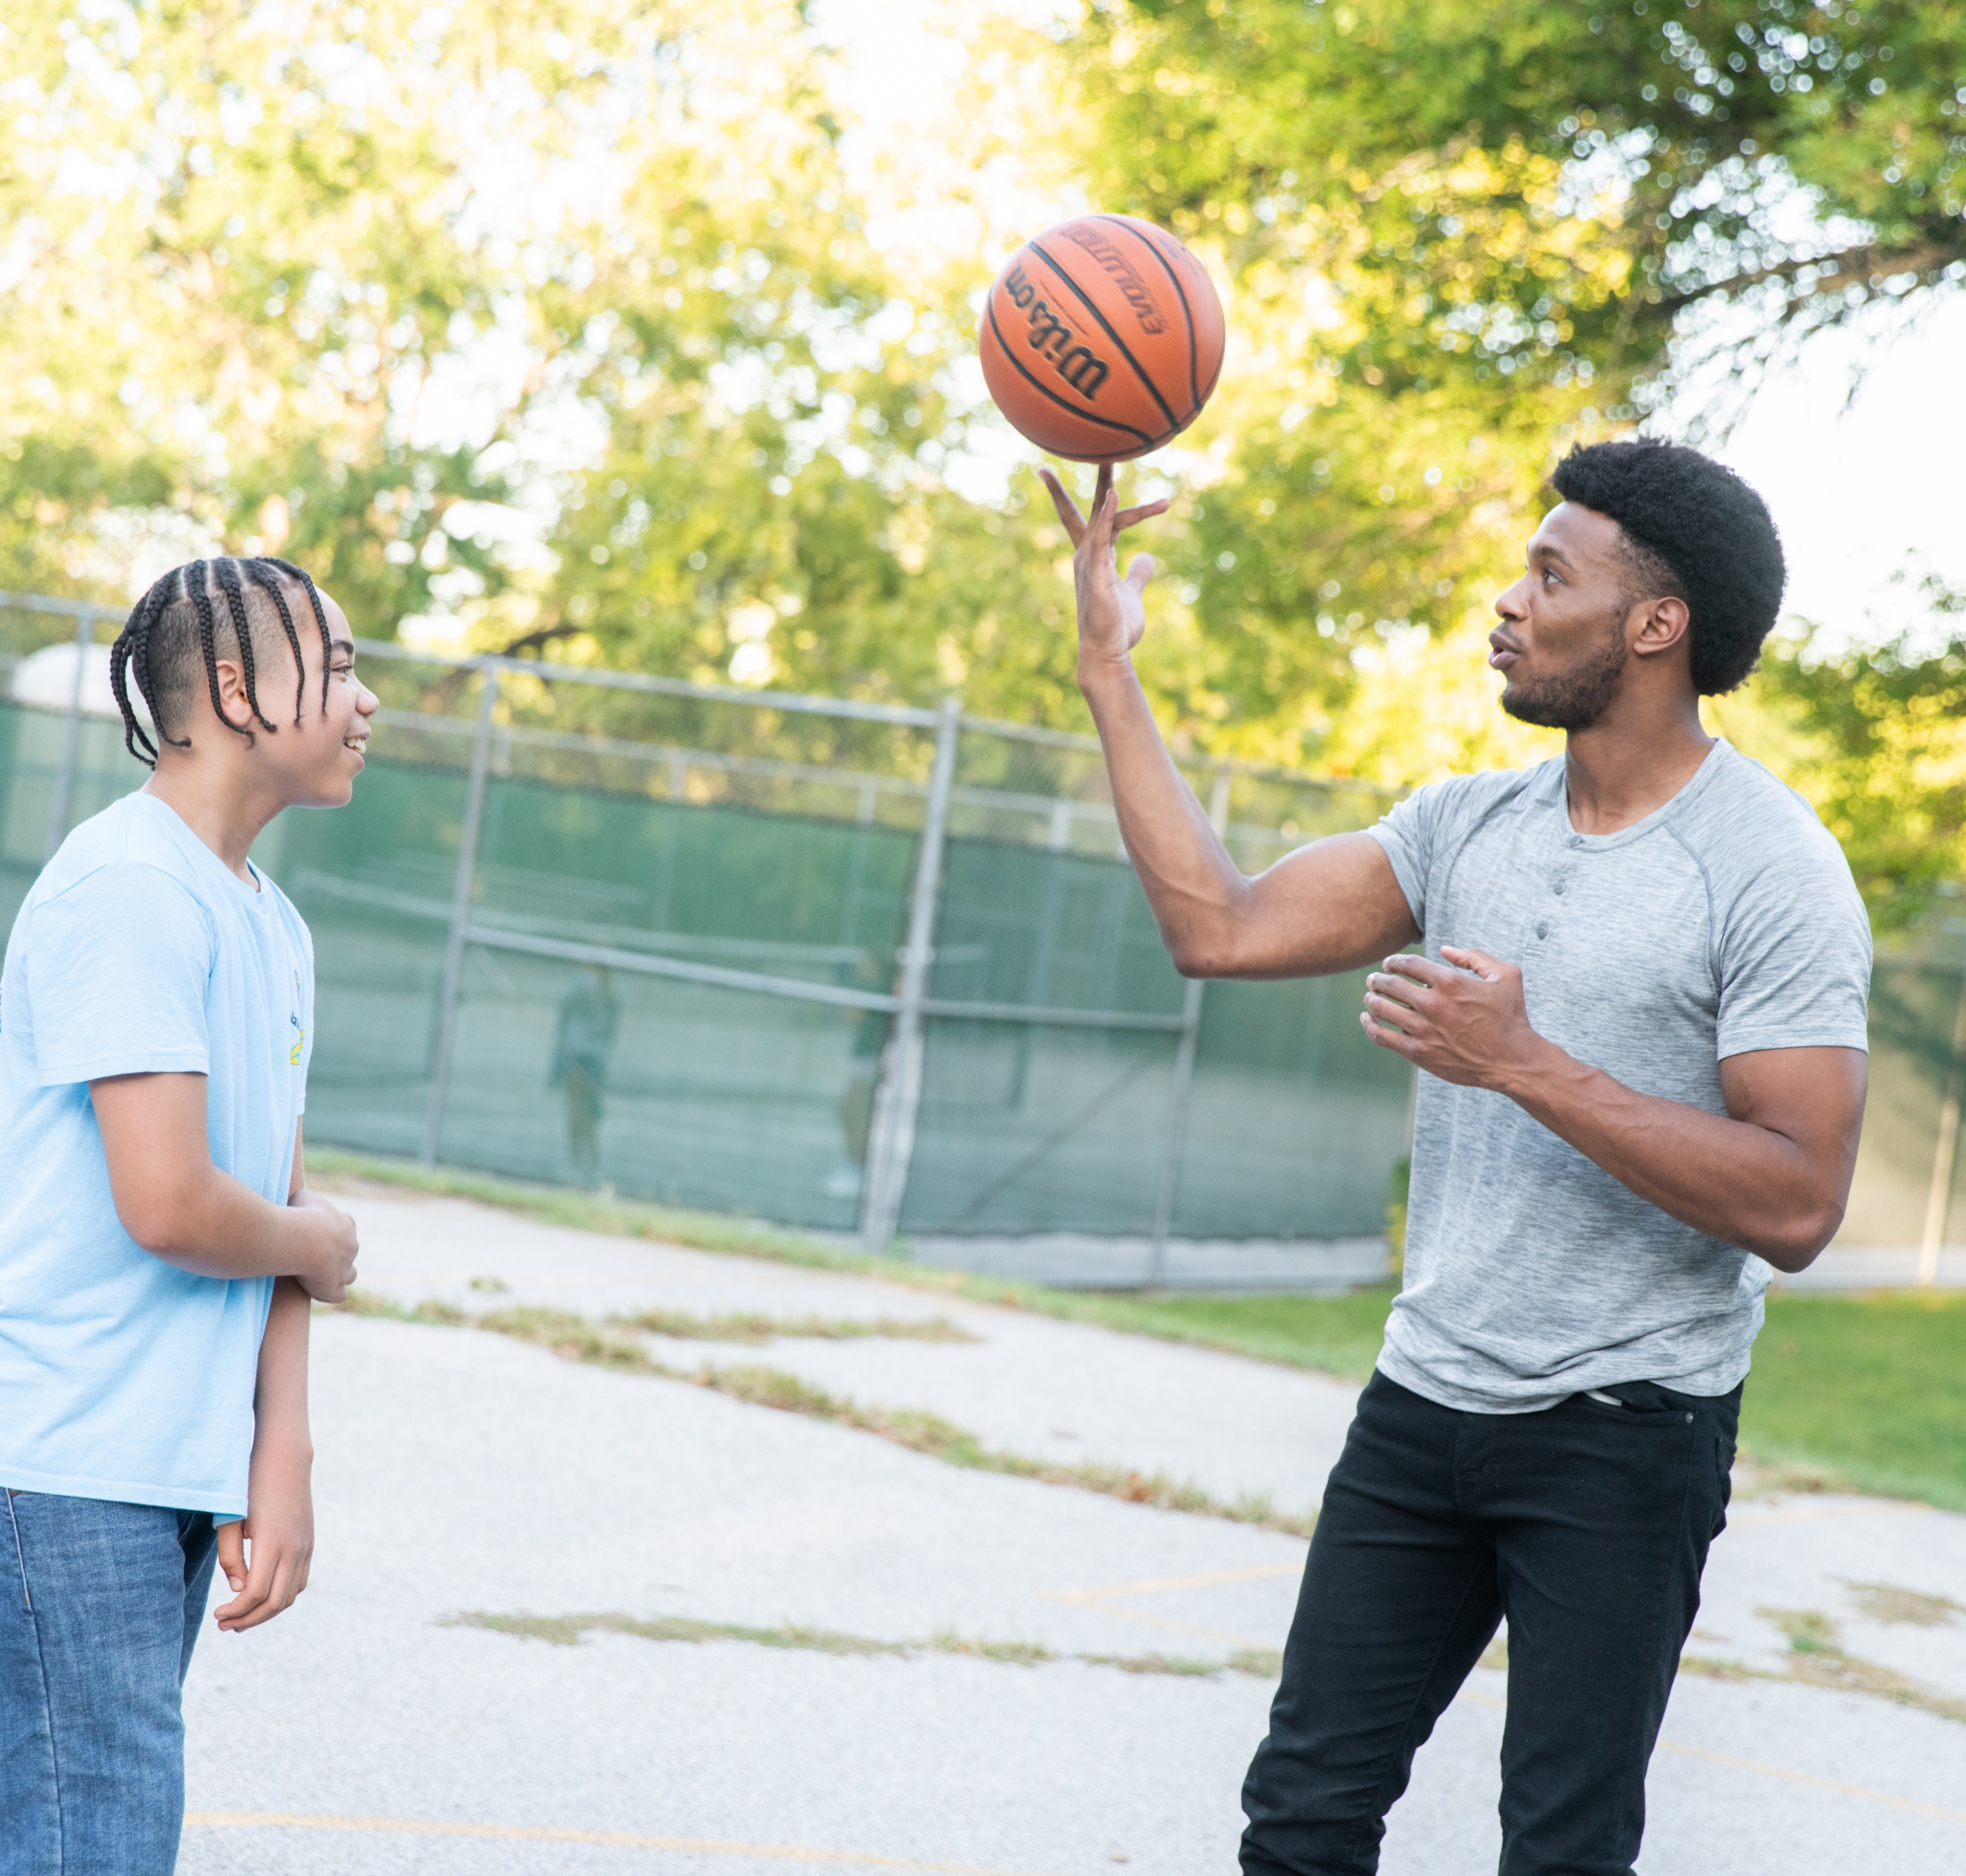
Approaches
To
Mentoring

Slide 41
Prescriptive Approach
Focuses on perceptions of youth’s deficits
Gives advice more than listens
Control's choice of activities
Tries to “fix” the youth
Judges' youth

Slide 42
Strengths Based Approach
Focuses on the youth’s strengths and assets
Listens and asks questions
Gives the youth voice and choice
Focuses on have fun
Suspends judgement

Slide 43
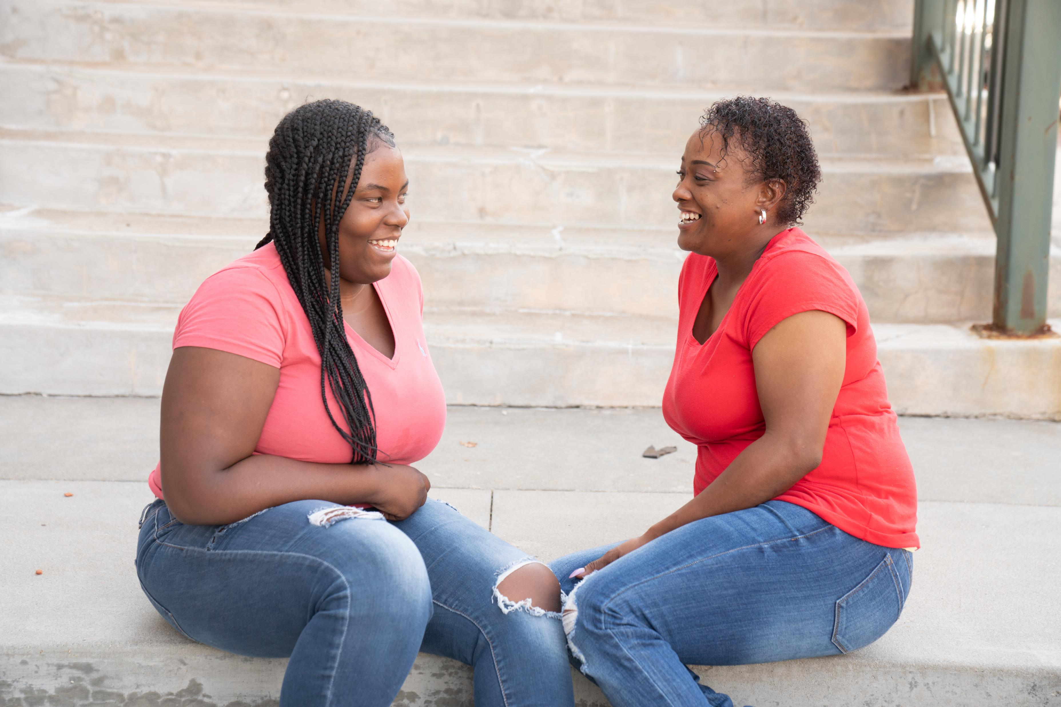
Cultivating a Supportive Relationship

Slide 44
Empathy
: the action of understanding, being aware of, being sensitive to, and vicariously experiencing the feelings, thoughts, and experience of another of either the past or present without having the feelings, thoughts, and experience fully communicated in an objectively explicit manner

Slide 45
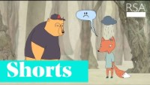

Slide 46
Reflective Listening
Hearing and understanding what the other person is communicating through words and “body language” to the best of your ability
Responding to the other person by reflecting the thoughts and feelings you heard in his or her words, tone of voice, body posture, and gestures

Slide 47

Examples
"It sounds like..."
"It seems as if..."
"What I hear you saying..."
"I get a sense that..."
"It feels as though..."
"Help me to understand. On the one hand you... and on the other hand..."

Slide 48

Activity
Think about a personal or professional challenge you're currently navigating that you would be willing to share with the group
Breakout rooms in pairs of 2
  Determine who is the listener and who will be the speaker
  The speaker will talk for 2 min. about their challenge
  The listener will then respond with a statement reflecting their perception of the speakers' feelings

Slide 49


Open vs. Closed Questions/Responses
Open:
Closed:
Encourages further communication and sharing of feelings. They show that you understand (not necessarily agree).
Blocks communication by showing little or no understanding of feelings. Often passes judgment, interrupts or analyzes rather than supporting.

Slide 50

Let’s Practice
Mentee: I hate math class! My works is too hard to do.
  Closed Response > Ask the teacher for help
  Open Response > Seems like you feel fed up with your math class
Mentee: My classmate makes me so mad I could just hit them.
  Closed Response > Fighting is bad. Don’t do it.
  Open Response > *group share*
Mentee: I can’t believe everyone saw me fall in gym class.
  Closed Response > Even professional athletes fall sometime.
  Open Response > *group share*
Mentee: I hate my haircut. It makes me look stupid.
  Closed Response > It looks fine to me.
  Open Response > *group share*

Slide 51

Setting Healthy Boundaries

Slide 52
Types of Boundaries
Physical
Intellectual
Emotional
Material
Time

Slide 53

Setting Boundaries
What Should I share?
What Shouldn’t I share?
Is it okay to hug my mentee?
Think about what boundaries you want to set early
Talk to your mentee about boundaries
Model healthy boundaries
Be consistent
Do not judge
Help your mentee navigate social and professional expectations
Lisa Bottomley, M. (2021, March 19). Mentoring – Part 6: Setting boundaries. Retrieved April 26, 2021, from https://www.canr.msu.edu/news/mentoring_part_6_setting_boundaries

Slide 54

Roadblocks to Creating a Supportive Relationship

Slide 55
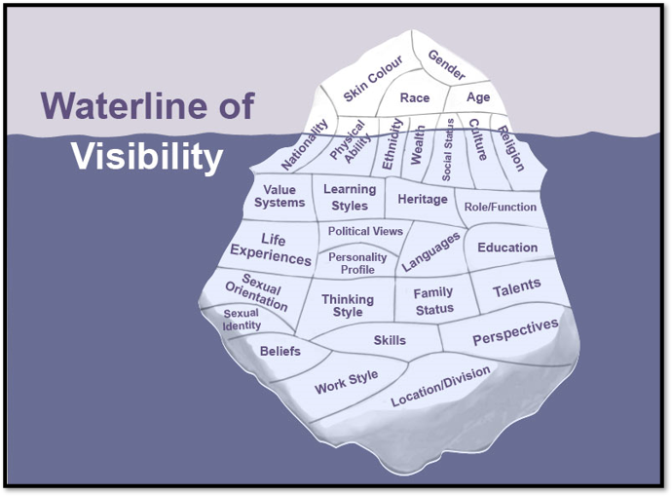
Cultural Iceberg

Slide 56
It's time to address your bias...
Promote self-awareness- Implicit Association Test (IAT)
Understand the nature of bias- Categorization that gives rise to bias is a normal aspect of human cognition
Positive contact with people from groups who you may have bias makes it more difficult for the brain to categorize people
Join in on facilitated discussions and training sessions promoting bias literacy
Youmans, S. (n.d.) Strategies to address unconscious bias. Retrieved May 26, 2021, from https://diversity.ucsf.edu/resources/strategies-address-unconscious-bias

Slide 57
Self Exploration- Disrupting Potential Bias
What is your motivation to be a mentor?
What are your goals for being a mentor?
Consider the people who mentored you or were closest to you when you were a child- how did they treat you? What were (or are) your feelings about that?
How might your childhood experience affect your experience and ability to be an effective mentor?
Framework for understanding adultism. (n.d.). Retrieved May 26, 2021, from http://www.actforyouth.net/resources/pyd/pyd_3-3_framework-adultism.pdf

Slide 58
Have you heard of Adultism?
Dysfunctional Rescuing
Blaming the Victim
Avoidance of Contact
Denial of Distinctiveness of Youth Culture
Denial of Political Significance of Adultism
Framework for understanding adultism. (n.d.). Retrieved May 26, 2021, from http://www.actforyouth.net/resources/pyd/pyd_3-3_framework-adultism.pdf

Slide 59
The Cycle of White Saviorism
The dominant culture controls who is in/out. It cannot help but perpetuate itself.
Non-white culture is inferior, those outside of white culture must be brought into white culture to be successful. They must be "saved" from themselves...
Then any kind-hearted and well-intentioned person should help others "see the light"
MENTOR Nebraska. (2020, August 19). Combatting White Saviorism [Video]. Vimeo. https://vimeo.com/449455493

Slide 60
White Savior Narratives in Mentoring
Individual people of color can overcome their circumstances but only with the help of their white mentors
Urban spaces and the people of coloring living in them are inherently threatening, dangerous, and criminal
White people are willing to deal with individual "deserving" people of color, but whites do not become a part of the peoples of color's community in any meaningful way
White people who are willing to save or help people of color, at seemingly great personal cost, are noble and courageous
White people who are willing to "deal with" individual people of color are morally superior to other white people
MENTOR Nebraska. (2020, August 19). Combatting White Saviorism [Video]. Vimeo. https://vimeo.com/449455493

Slide 61
Having Conversations About Race With Your BIPOC Mentee
We have a responsibility to acknowledge race in the mentoring space
  Acknowledging race validates a young persons lived experience
  Not Acknowledging race inherently devalues the racialized experience of young people

Slide 62
How Can We Approach Conversations About Race With Youth?
3 characteristics that are necessary for any adult working with youth to understand and apply
  Openness- having a barrier (such as a door) so adjusted as to allow passage
    The adult's ability to open up to their own learning and being willing to engage in conversation with a young person
  Understanding- an agreement of opinion or feeling: an adjustment of differences
    The adult comes to the conversation with humility, knowing that they have a different and limited perspective on the topic
  Vulnerability- uncertainty, risk, and emotional exposure
    The adult should understand that a mentee is putting him or herself in a vulnerable position having this conversation, and the adult should match that vulnerability

Slide 63
3 Characteristics Lead to 1 Action
Openness
Understanding
Vulnerability
Validation

Slide 64
Questions

Slide 65
Additional References
Kirby. (2020, November 12). How to grow great mentor relationships. Retrieved May 07, 2021, from https://kirbyingles.com/how-to-grow-great-mentor-relationships/
Lisa Bottomley, M. (2021, March 19). Mentoring – Part 6: Setting boundaries. Retrieved May 07, 2021, from https://www.canr.msu.edu/news/mentoring_part_6_setting_boundaries
Developmental relationships framework. (2019, September 06). Retrieved May 07, 2021, from https://www.search-institute.org/developmental-relationships/developmental-relationships-framework/

